Slide 1
VIRTUAL PIANO
Nish Dara, Thomas Franklin, Devon Grove, Blaine Weeks
“Do it for the Rackets”

Slide 2

The idea
Interactive program
Must be entertaining
Simple, yet complex
Usable by everyone

Slide 3
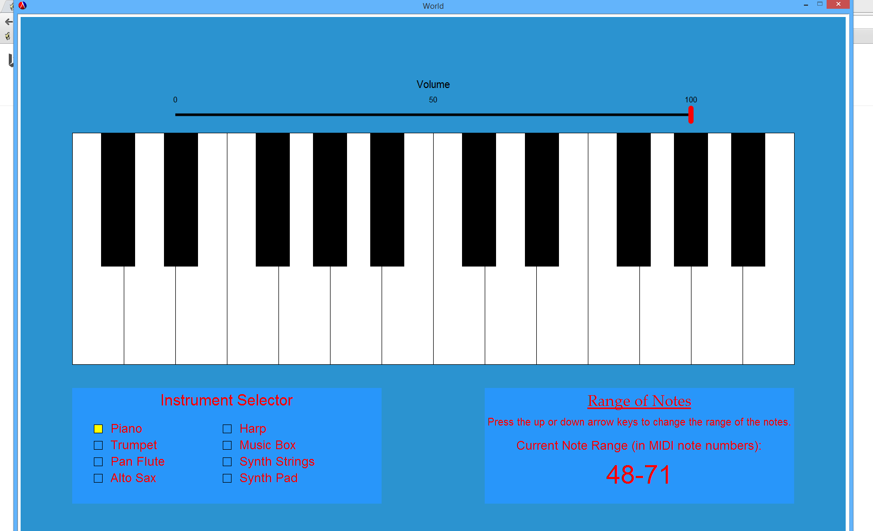
Prototype
Two octaves of piano keys
Pressing different keys on your keyboard plays different notes
Room for expansion

Slide 4

Extending the idea
Recording multiple lines
Metronome
Preset songs
Playback

Slide 5
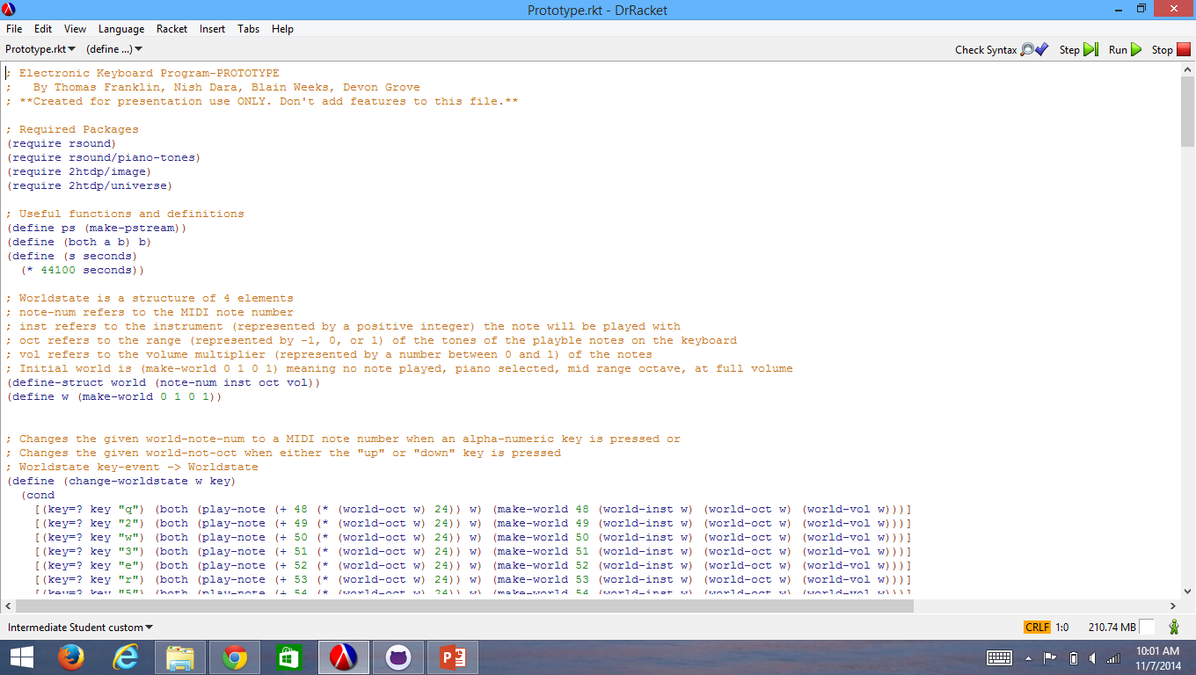
Investing in the idea
Replayability
Expandable
Planning tool
“Limitless potential, limitless possibility, limitless power.”

Slide 6
QUESTIONS?

